Slide 1

Trip Analysis for NYC Yellow Taxi Data Group 19
Amit Bhasita
Suvam Mukhopadhyay
Heet Dave
Shubhashish Shukla
Yashil Jogi
Rohit Kumar
Harshkumar Kakadiya
Ausaf Hussain
Kushagra Srivastava
Indian Institute of Technology Kanpur
CS 661: Big Data Visual Analytics

Slide 2
Introduction
The objective of this project was to explore and analyze the NYC Yellow Taxi 2022 dataset (sourced from Kaggle) to uncover key insights into taxi trip patterns, fare behavior, and geographic trends across New York City. Our analysis focused on:
Visualizing trip and fare patterns on interactive maps
Assessing fare efficiency across locations and time periods
Creating demand heatmaps to identify high-activity zones
Through these insights, we aim to enhance the understanding of urban mobility and provide actionable strategies for optimizing taxi operations.
241110008
CS 661: Big Data Visual Analytics

Slide 3
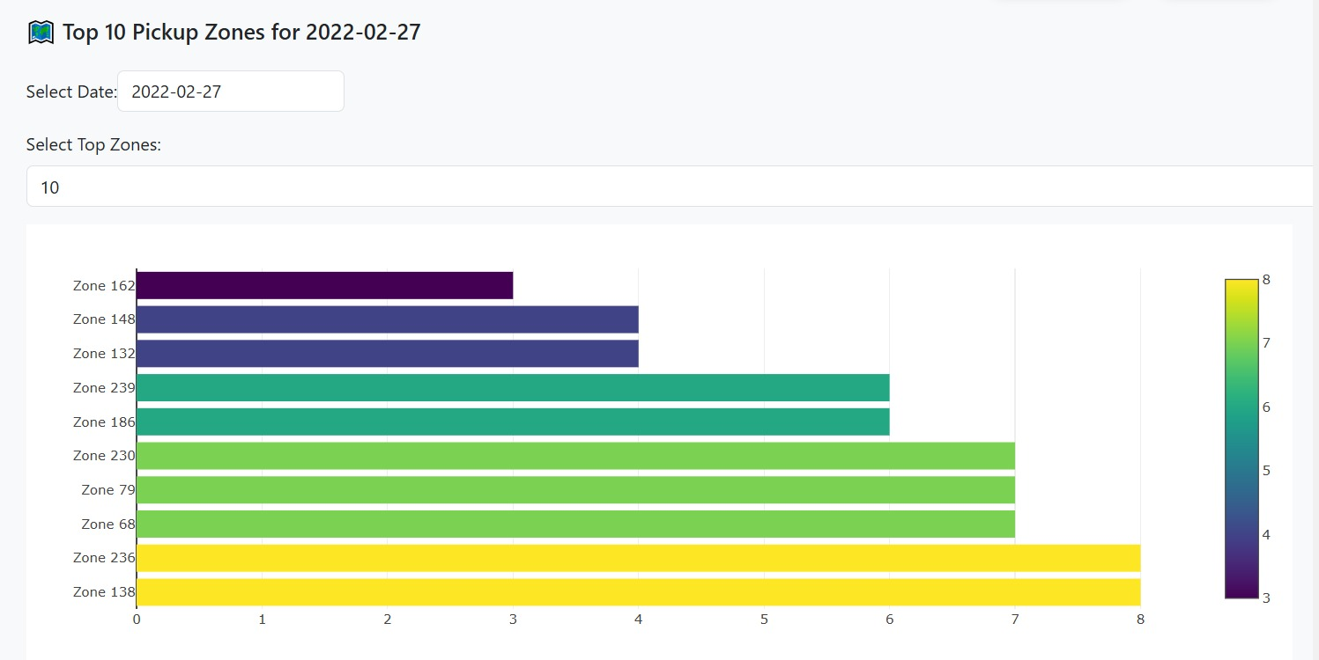
Top 10 Pickup Zones (Horizontal Bar Chart)
X-axis: Number of trips
Y-axis: Zone names (zone IDs)
Color: Based on number of pickups (heatmap color scale)
Visualizes busiest pickup zones geographically.
Useful for city planning (placing taxi stands, managing traffic).
Card payments dominate tipping behavior.
241110008
CS 661: Big Data Visual Analytics

Slide 4
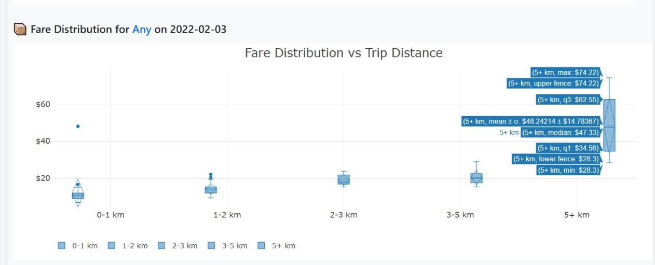
Fare Distribution vs Distance (Boxplot)
X-axis: Trip distance groups (0–1 km, 1–2 km, etc.)
Y-axis: Fare (in USD)
Median fare increases with distance group.
Spread (variability) is much higher for 5+ km trips.
Identifies outliers — some long trips have relatively low fares.
Card payments dominate tipping behavior.
241110008
CS 661: Big Data Visual Analytics

Slide 5
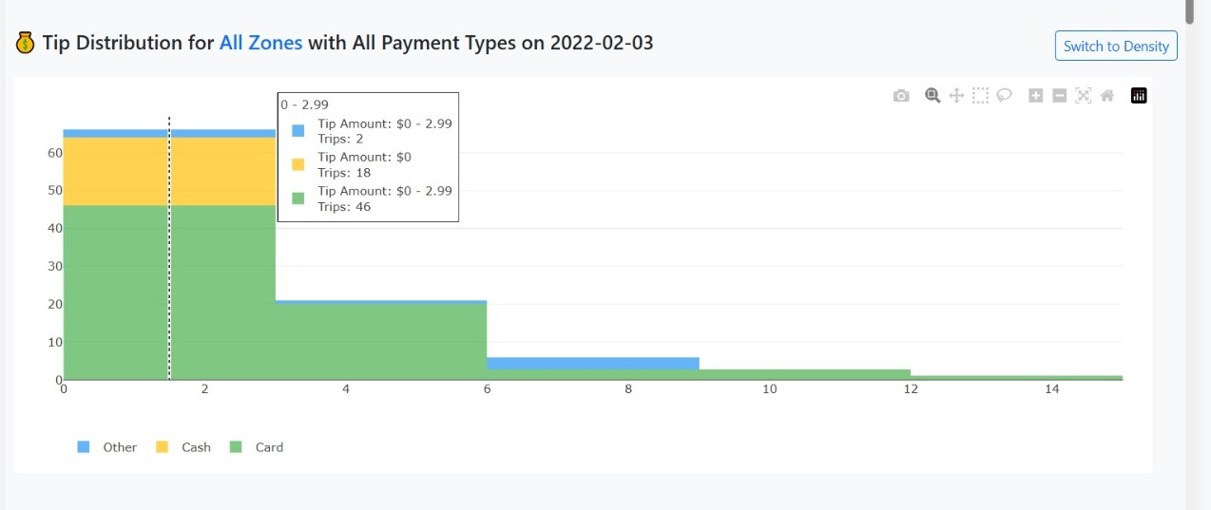
Tip Distribution (Stacked Bar Chart)
X-axis: Tip amount range (e.g., $0–2.99, $3–5.99, etc.)
Y-axis: Number of trips
Donut chart provides easy relative comparison.
Stack colors: Payment type used (Cash, Card, Other)
Most trips had tips between $0–$3
Card payments dominate tipping behavior.
Card payments dominate tipping behavior.
241110008
CS 661: Big Data Visual Analytics

Slide 6
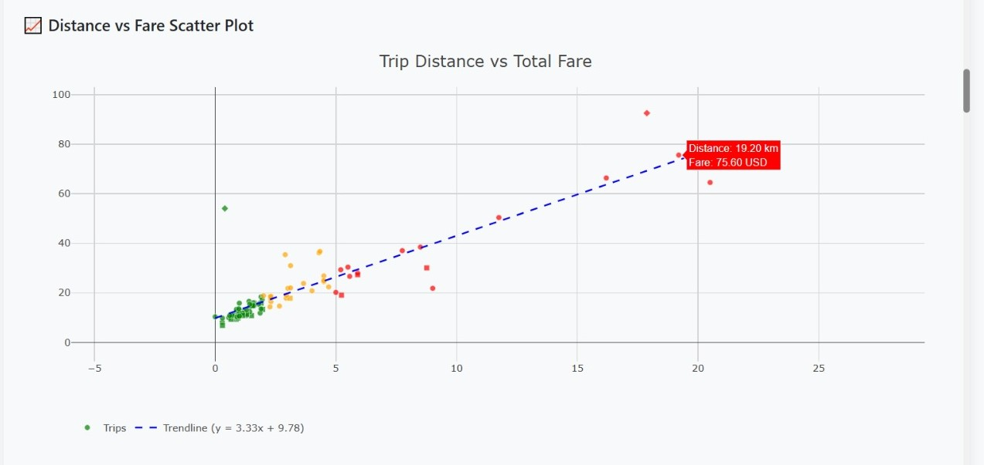
Distance vs Fare Scatter Plot
X-axis: Trip Distance (in kilometers)Y-axis: Total Fare (in USD)
Each dot = one trip.Short trips (left side) usually have low fares.Long trips show more variability (some high fare, some lower than expected).
Trendline shows overall expected fare increases with distance
241110008
CS 661: Big Data Visual Analytics

Slide 7
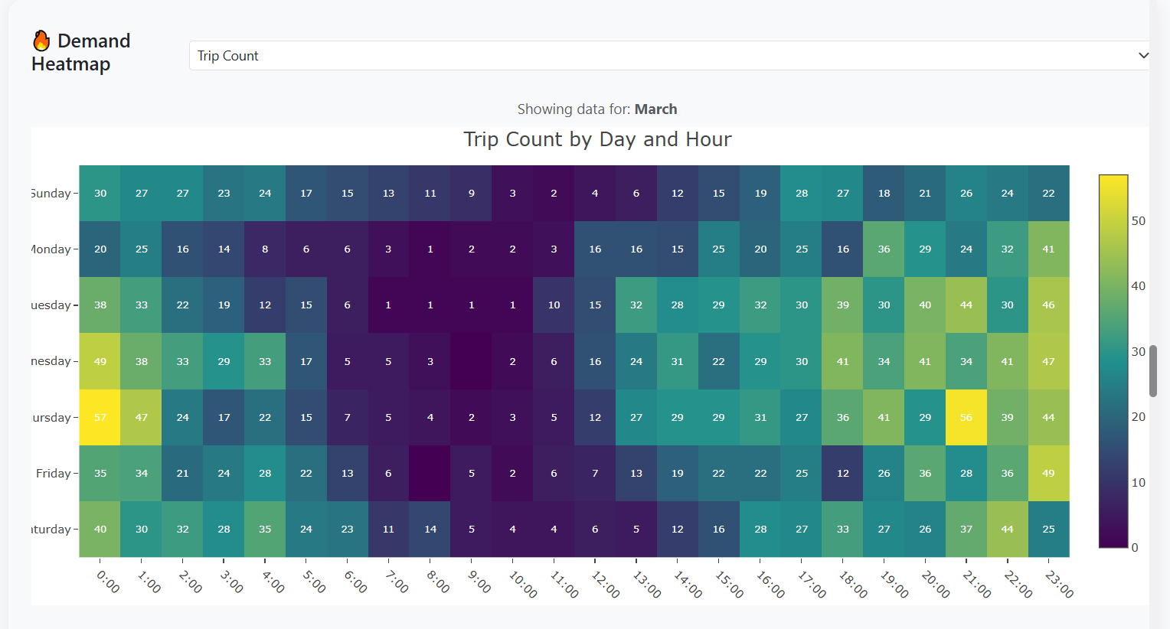
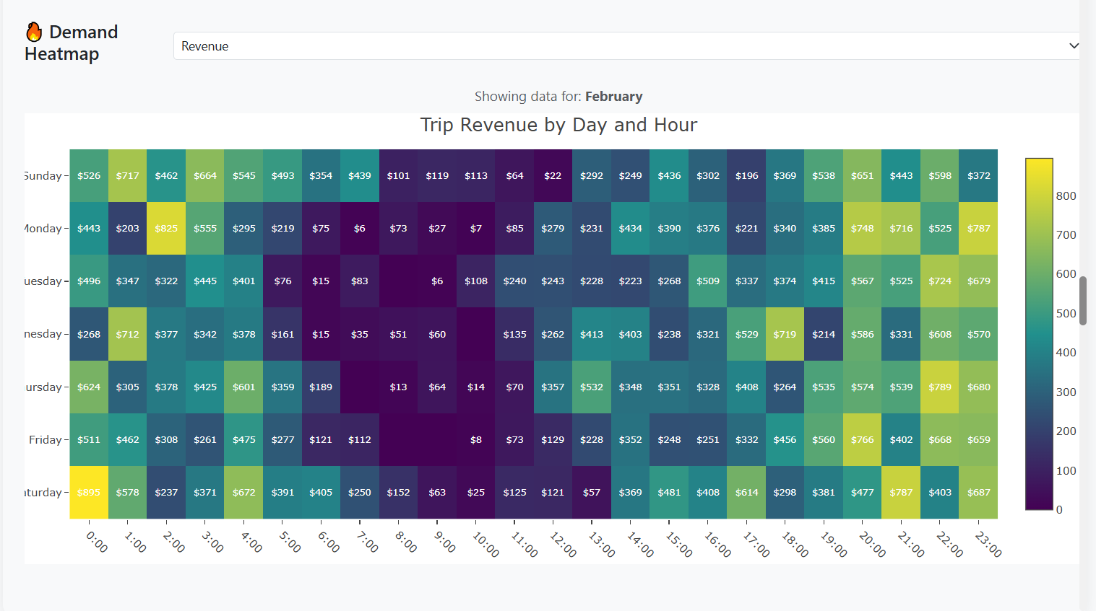
Demand Heatmap
Visualizes trip count and revenue patterns across days and hours.
Data filtered by selected month and hour range.
Two views: Number of trips vs Total revenue.
X-axis: Hour of Day | Y-axis: Day of Week.
Brighter colors = higher demand or higher earnings.
Helps identify peak periods and optimize driving strategies.
241110008
CS 661: Big Data Visual Analytics

Slide 8
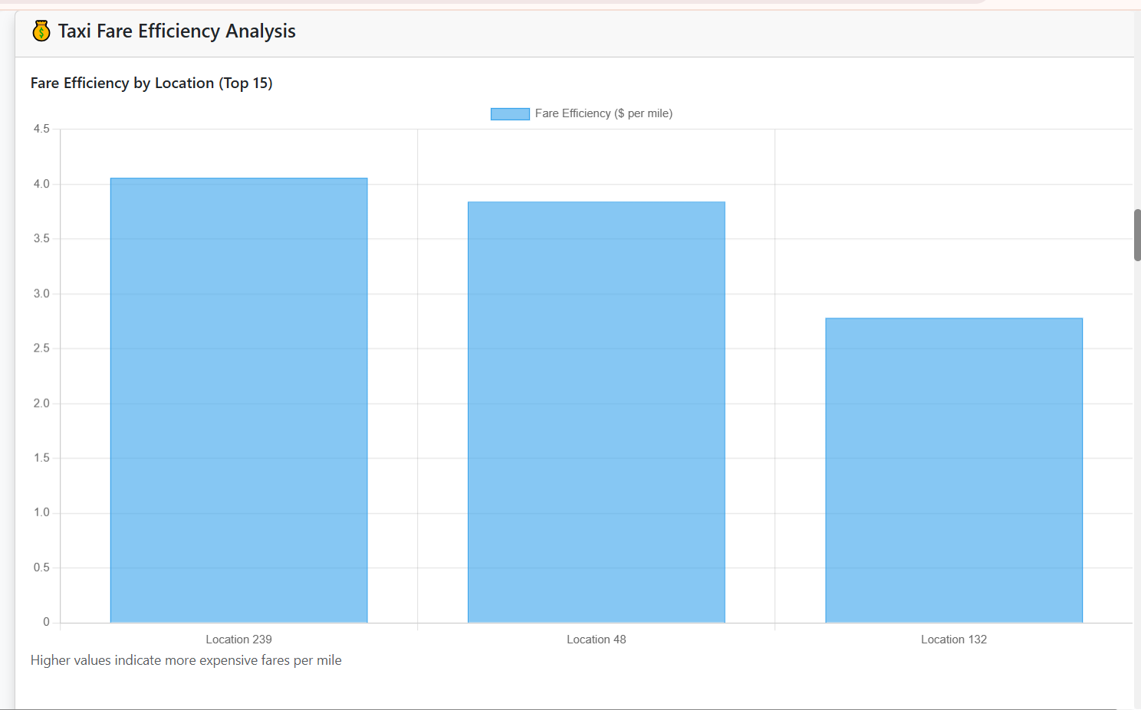
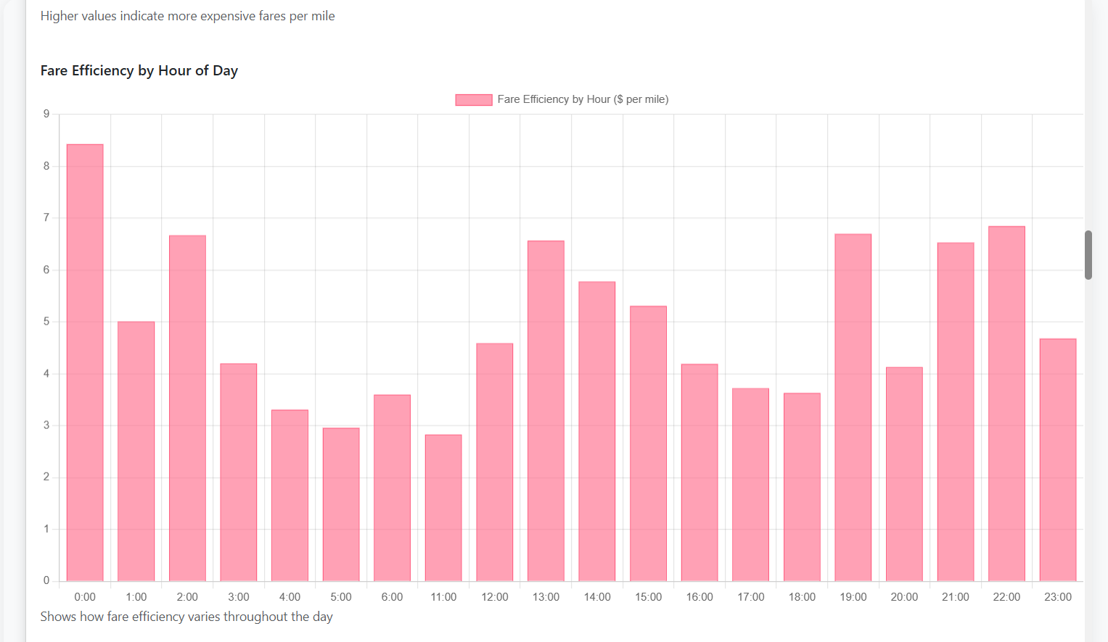
Fare Efficiency Analysis
Analyzes fare earned per mile across trips.
Filters data by date and hour range.
Visualizes top 15 pickup locations and hourly efficiency.
Scatter plot shows fare efficiency vs trip distance.
Helps identify profitable zones and optimal working hours.
Uncovering when and where taxi trips deliver the highest returns.
241110008
CS 661: Big Data Visual Analytics

Slide 9
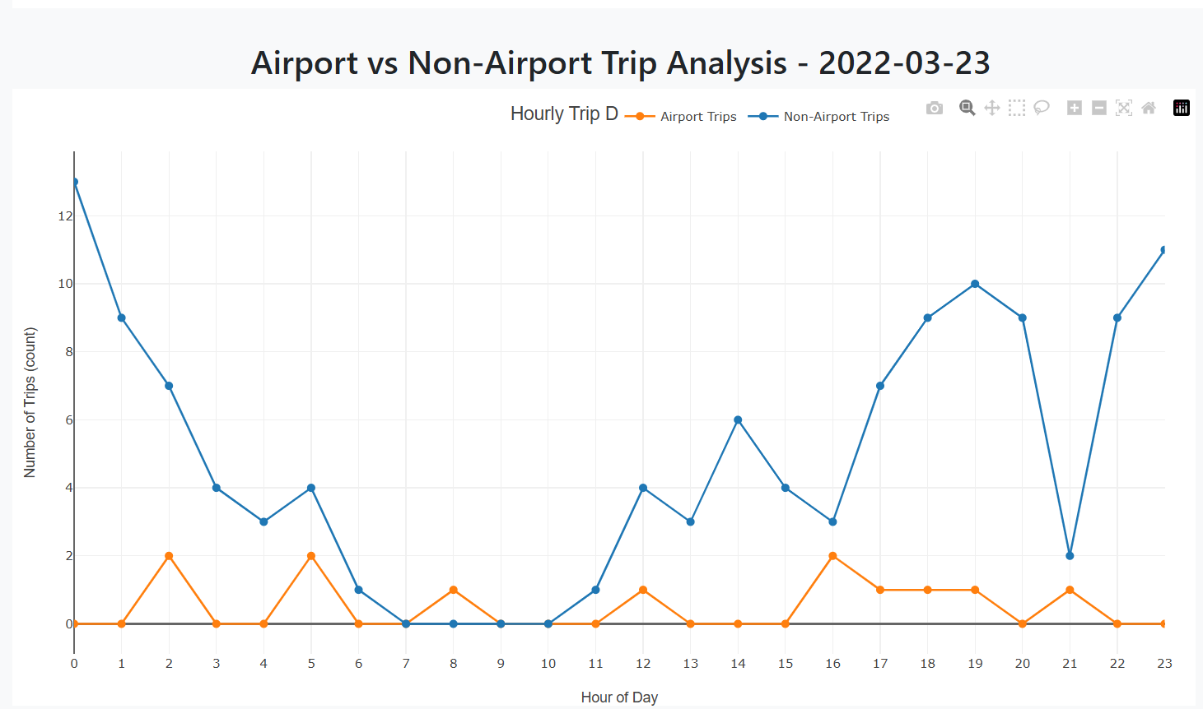
Airport vs Non-Airport Trip Analysis
Data filtered by selected date, hour range, and optionally vendor and payment type.
Compares hourly distribution of airport trips and non-airport trips.
Line chart plots trip counts for each hour of the day (0–23).
Helps identify peak times for airport and city trips separately.
Understanding when airport trips surge compared to regular city trips.
241110008
CS 661: Big Data Visual Analytics

Slide 10
Dynamic Fare Distribution Animation
Animates daily changes in taxi fare amount distribution for a selected month.
Filters trips by pickup date and plots fare histograms day-by-day.
Displays total number of trips for each day.
Interactive controls to Play, Pause, and Reset the animation.
X-axis: Fare Amount (USD) | Y-axis: Number of Trips.
Tracking how fare patterns evolve over time, day by day.
241110008
CS 661: Big Data Visual Analytics

Slide 11
Choropleth Map :-
Choropleth Map: Perfect for visualizing geographically distributed data.
Defined Taxi Zones: Each zone in NYC is clearly delineated, facilitating precise mapping of metrics.
Dynamic Metrics Display: Effectively visualizes variations in trip counts, average tips, and more.
Instant Visual Insights: Clearly highlights high and low values across the map for quick analysis.
Intuitive & Engaging: Provides an easy-to-understand, visually impactful representation of spatial data patterns.
241110008
CS 661: Big Data Visual Analytics

Slide 12
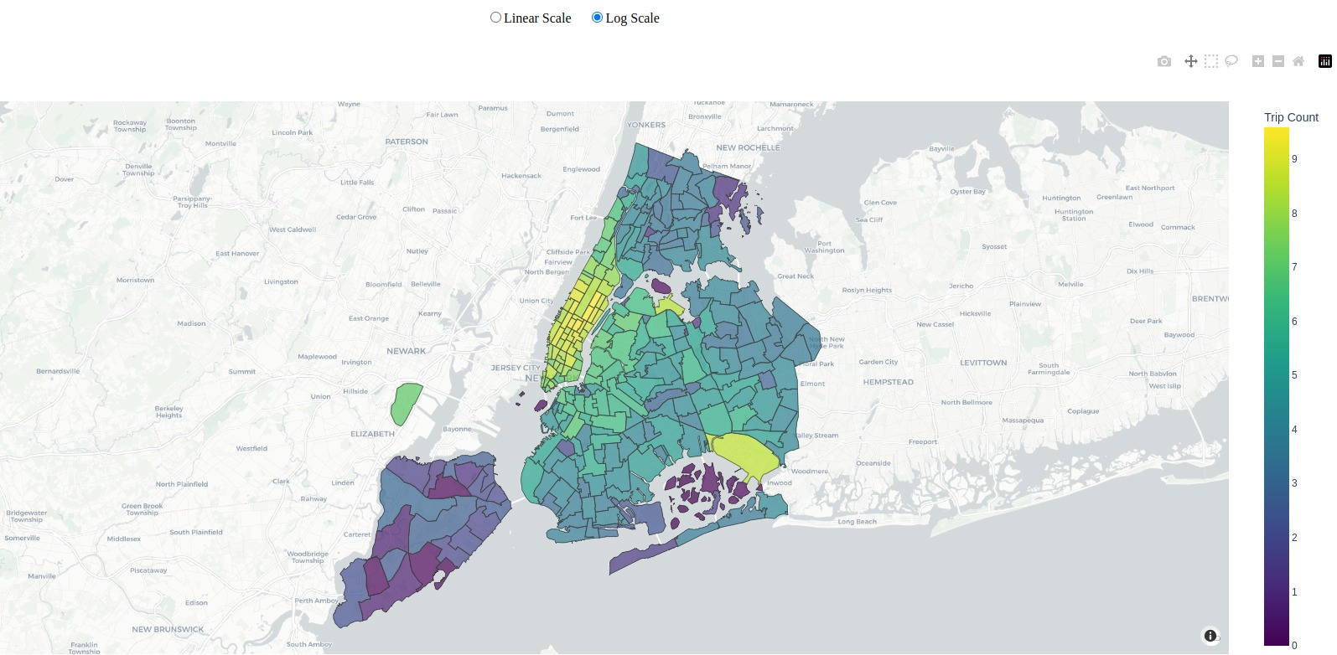
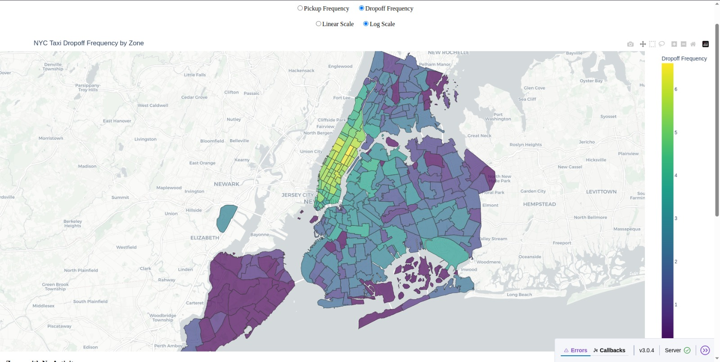
Dropoff comparison:
241110008
Fig 1: January 2022 drop-off frequency
Fig 2: December 2022 drop-off frequency
CS 661: Big Data Visual Analytics

Slide 13
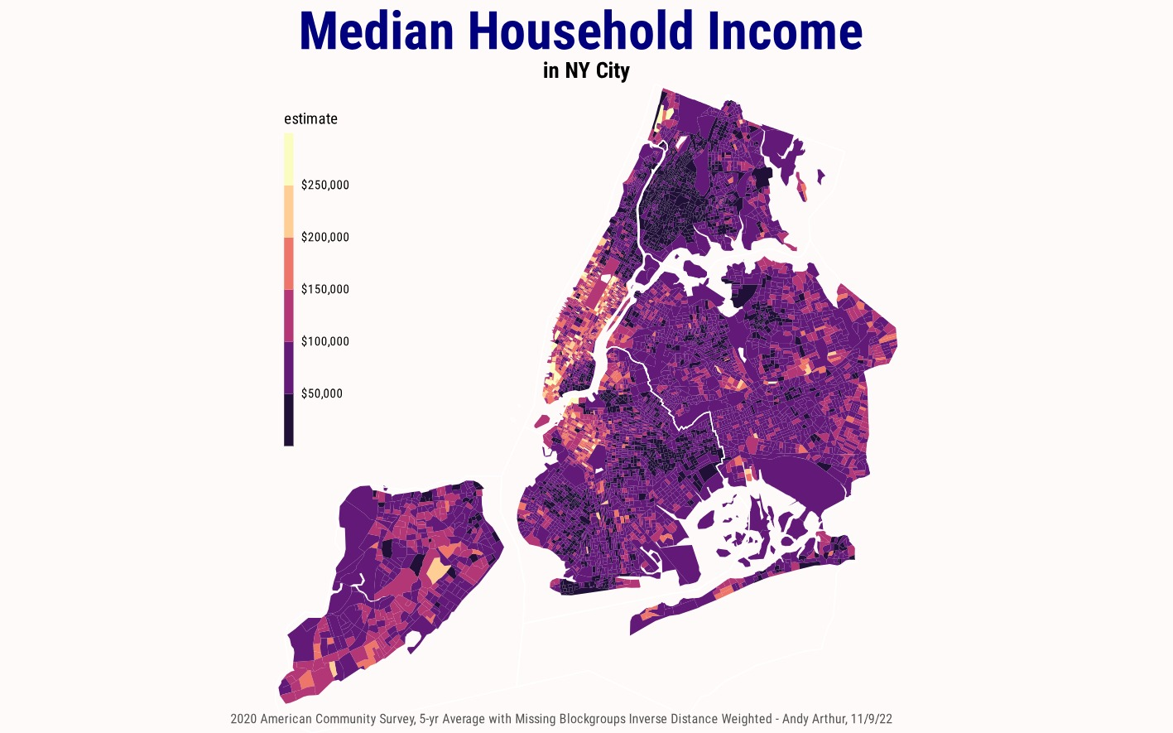
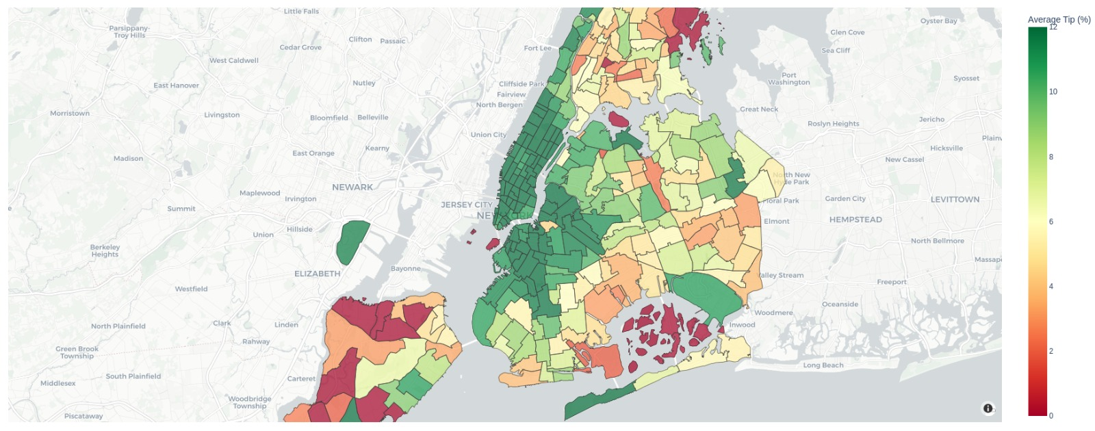
Socio-economic insights:
241110008
Fig 1: Choropleth Map of median income
Fig 2: Choropleth Map of Tipping percentage(December 2022)
CS 661: Big Data Visual Analytics

Slide 14
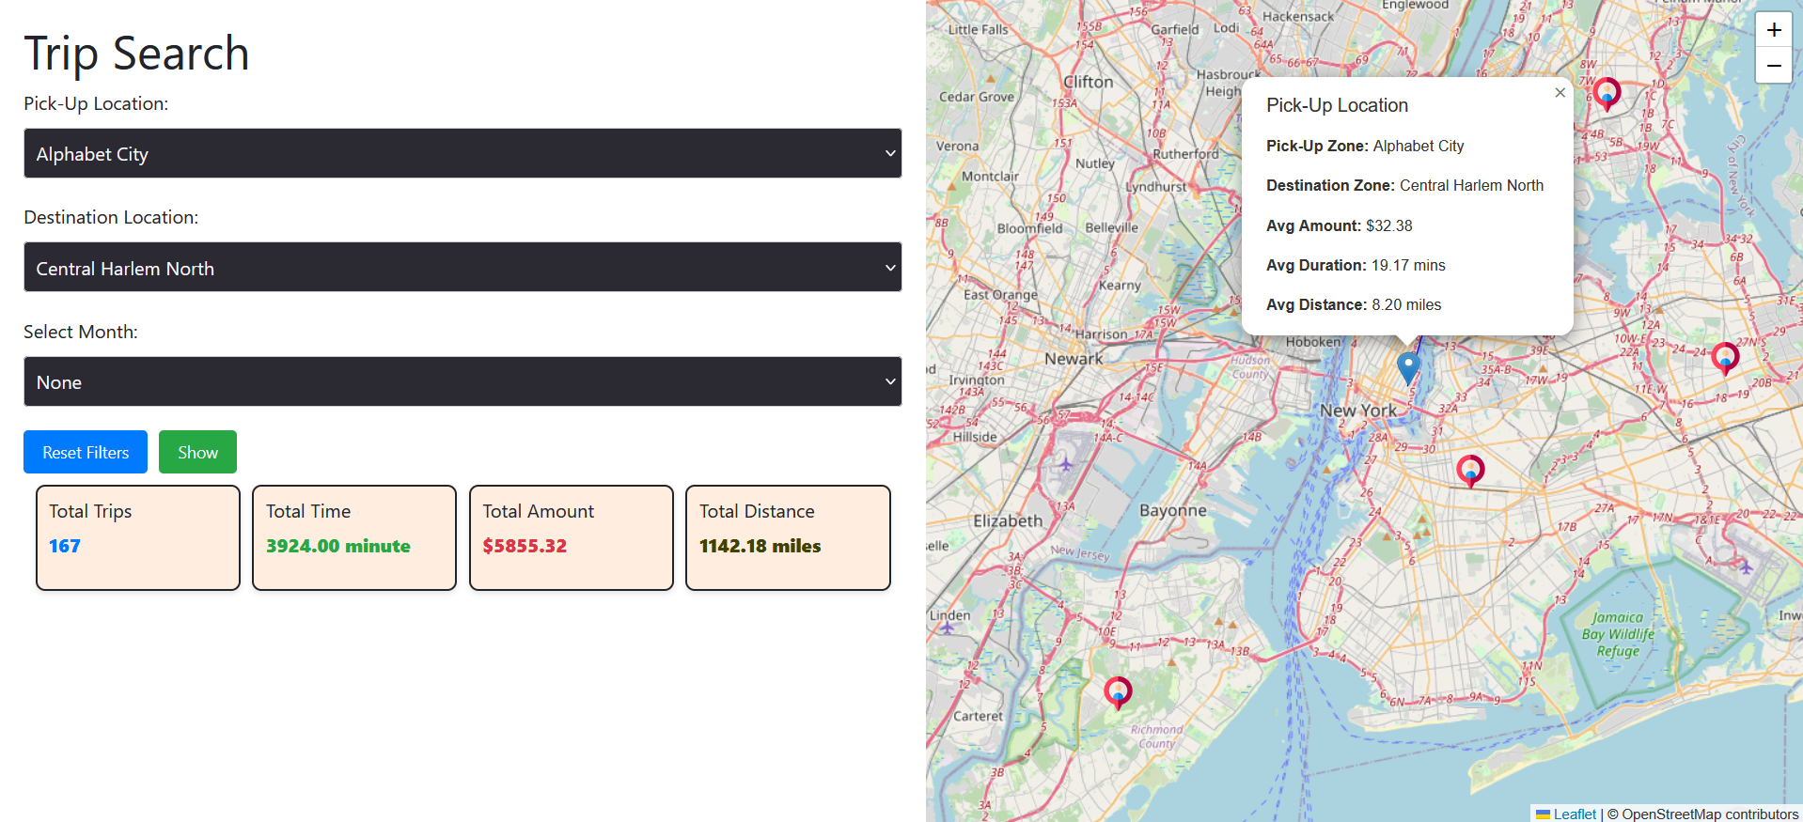
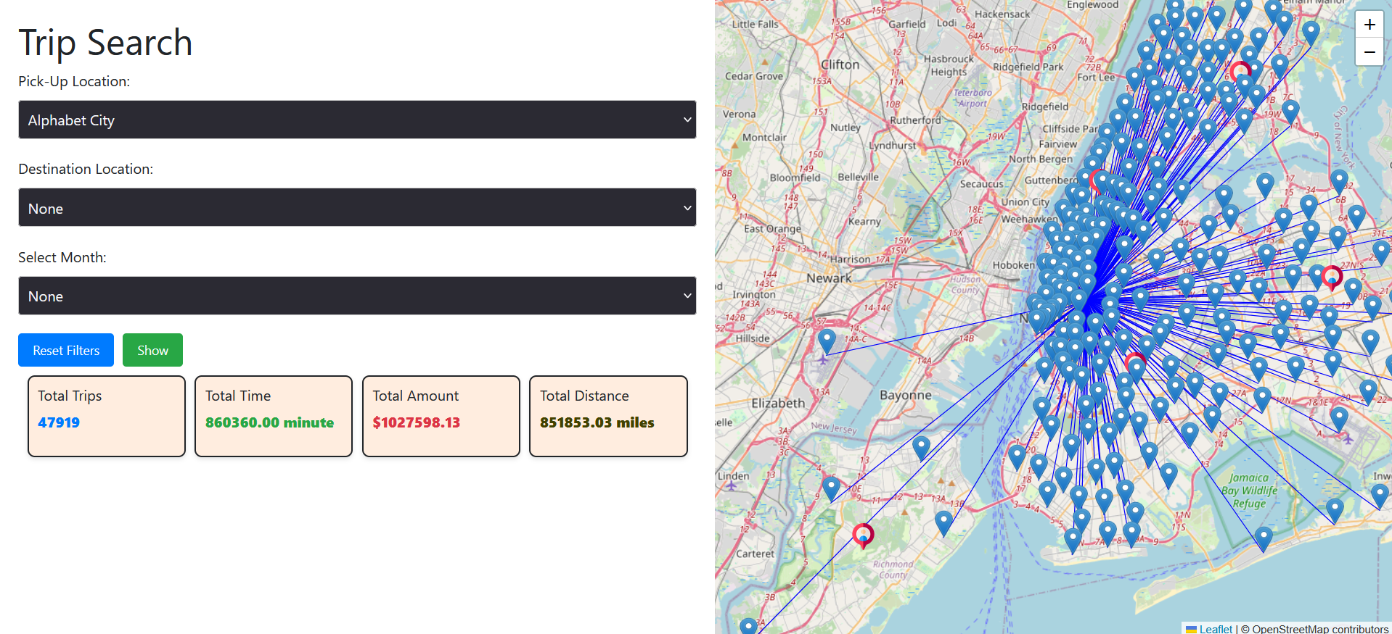
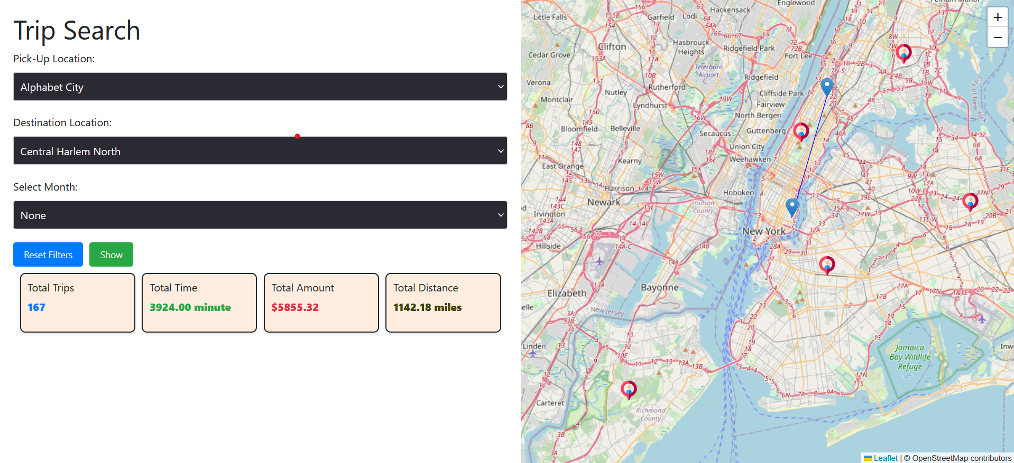
Geographic Mapping & Dynamic Filters:
Trips visualization on map based on user filtering
Monthly breakdown
Trip details popup on click to marker
24111000
CS 661: Big Data Visual Analytics

Slide 15
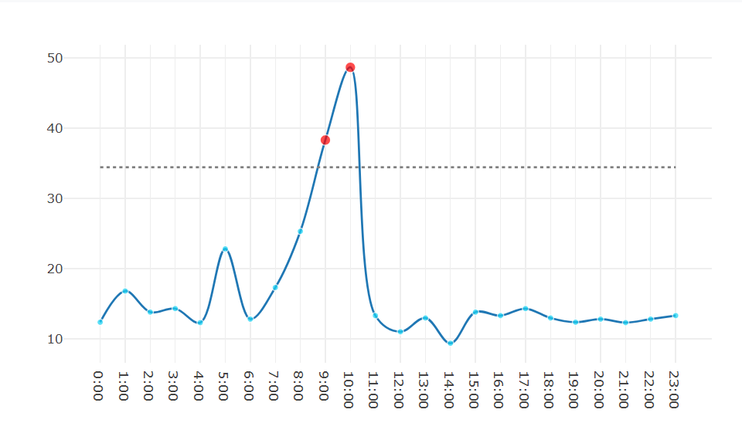
Surge Anomaly Detection
Shows comparison graph for median fare prices per hour.
Identify unexpected spikes in taxi fare price beyond forecast.
Flag the deviations that exceed predefined thresholds (set to 2 Standard Deviation).
Surge anomalies often caused by events, weather, or social phenomena.
Enables proactive taxi deployment and dynamic pricing strategies.
Real-time detection improves service efficiency during high demand.
241110008
CS 661: Big Data Visual Analytics

Slide 16
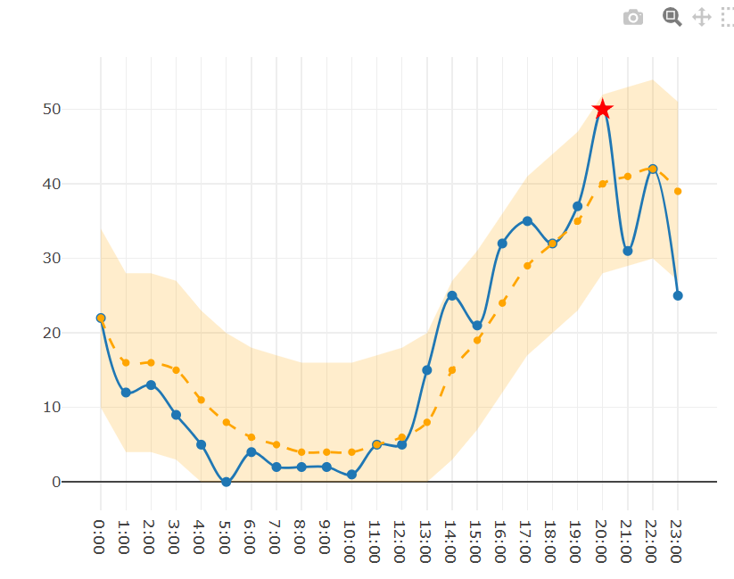
Trip Demand Forecast
Forecast hourly taxi trip demand based on historical data.
Use Ensemble approach for prediction of number of trips per hour.
Predicts future trip volumes with confidence intervals.
Helps optimize taxi availability during peak hours.
Confidence intervals quantify prediction uncertainty.
The actual points out of confidence intervals states that there is sudden high demand at that point.

Slide 17
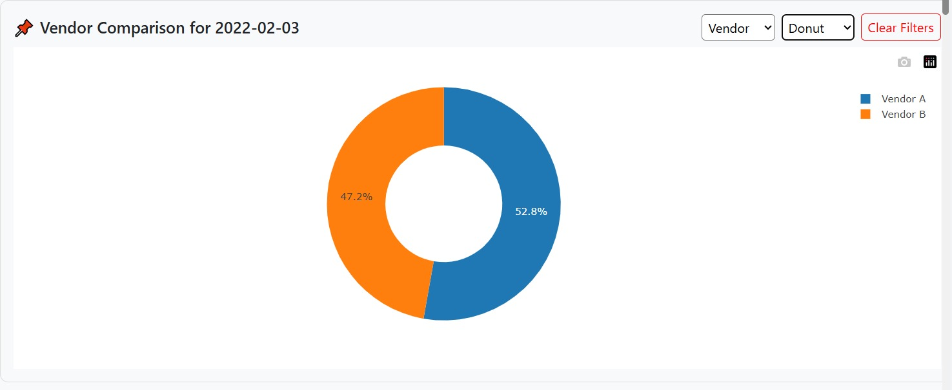
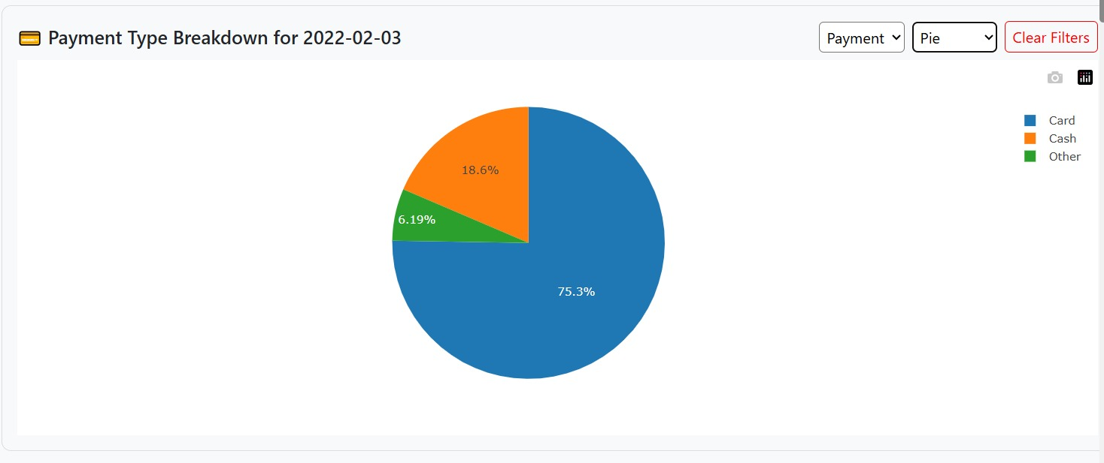
Vendor Comparison (Donut Chart)
Payment Type Breakdown (Pie Chart)
Different vendors (Vendor A, Vendor B)
Donut chart provides easy relative comparison.
Indicates successful adoption of digital payment methods.
75% of trips were paid by card, only 18% by cash.
Helps vendors plan for payment infrastructure and minimize cash handling.
241110008
CS 661: Big Data Visual Analytics

Slide 18
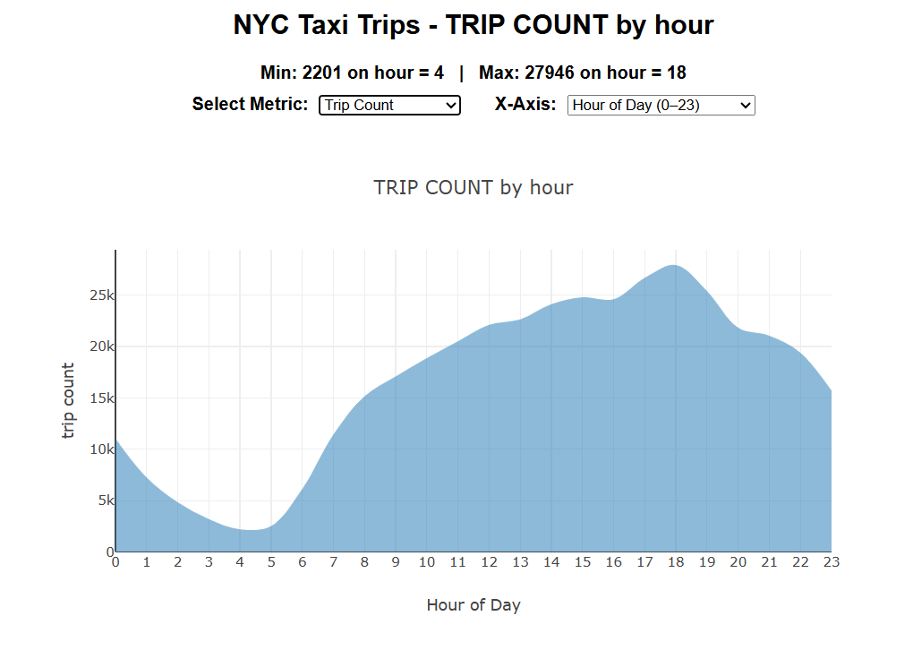
Area chart for analysis of overall trends:
X-axis (Drop down button):
Month (1–12)
Day of Month (1–31)
Weekday (Monday–Sunday)
Hour of Day (0–23)
Y-axis aggregation (Drop down button) :
Trip Count
Average Fare (in dollars)
Total Revenue (in dollars)
Average Tip (in dollars)
Total Tip (in dollars)
Average Distance (in miles)
Total Distance (in miles)
241110008
Insights:
October sees the maximum number of taxi trips while January sees the minimum, showing seasonal tourism and weather effects.
Taxi demand peaks around 6 PM daily, aligning with evening commute hours.
Average trip distance shows unusually long trips early in the morning (around 5 AM), likely airport trips.
CS 661: Big Data Visual Analytics

Slide 19
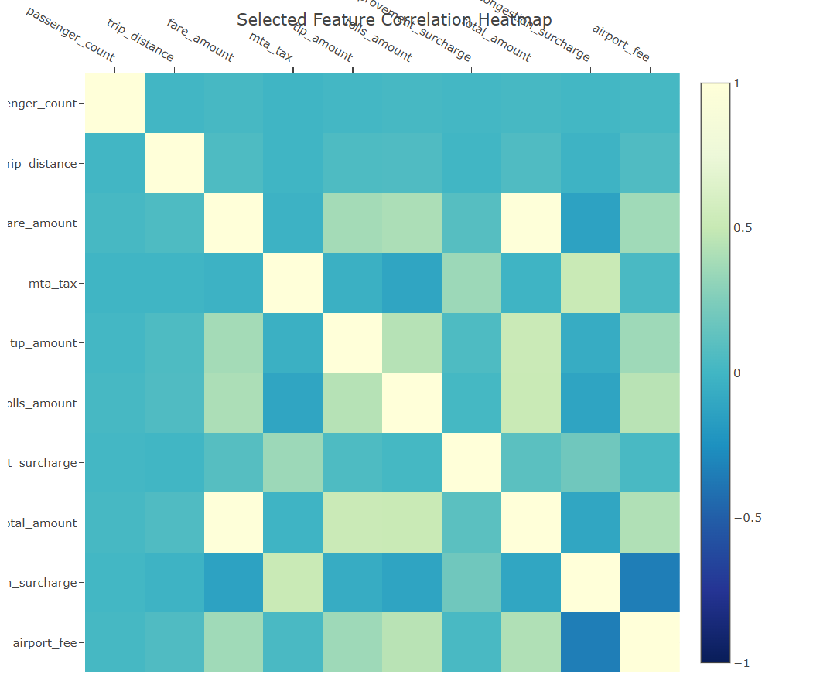
Heat map of overall correlations:
Heatmap (2D grid representing correlation coefficients between selected numerical features of taxi trips).
To understand how different features related to each other.
From the heatmap, it is observed that trip distance is not strongly correlated with total fare. This indicates that factors other than distance contribute significantly to the total amount paid by the customer.
Its calculating Pearson correlation over attributes.
241110008
CS 661: Big Data Visual Analytics

